Slide 1
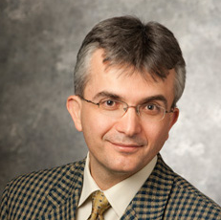


Achieving Rawlsian Justice in Food Rescue
Service Science Section Best Socially Responsible Paper Award Finalist
Aydin Alptekinoglu Gerdus Benade

Slide 2
Food insecurity and waste are common
USDA data on incidence of food insecurity in 2022 say:
12.8% of U.S. households
14.1% of global households
USDA estimates:
31% of all food in the US is wasted somewhere along the supply chain
92 billion lbs of food
Food rescue tries to address both issues at once
Match organizations with excess food to organizations that can distribute it where needed, in a timely manner
Notes:
ReFED (a nonprofit dedicated to fight food loss and waste)
Strengthening food rescue is among the seven key action areas they advocates for the next ten year

Slide 3
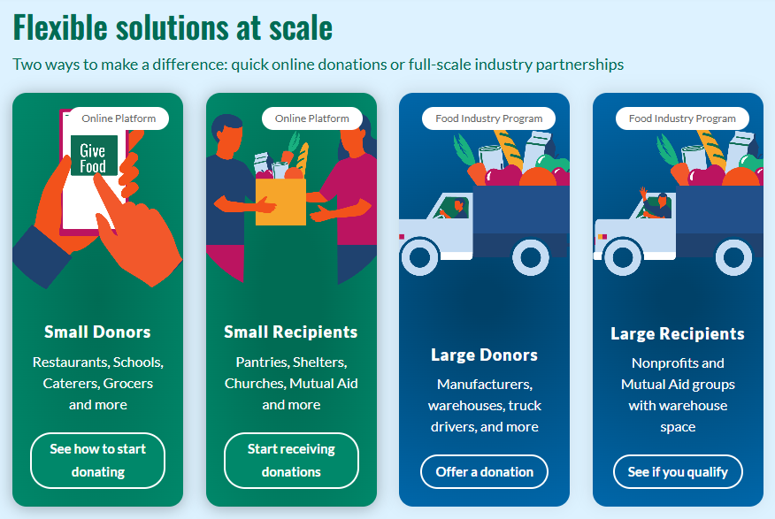
Setting: a national food rescue platform
Active in 50 states in the US
Distributed 2.9M pounds of food in 2022, 81M in 2024
Acts as a matching platform between donors and recipients
Notes:
FL in 2023: ~20 mil pounds. Exciting time to be involved with them.

Slide 4

Food rescue operations
Act as a matching platform between donors and recipients
Each recipient sets a pickup radius, on avg. ~55km.
Notes:
Recipients are food pantries/ soup kitchens not individuals. Pickup radius, also categories interested in

Slide 5




Food rescue operations
Act as a matching platform between donors and recipients
Notes:
Different radii

Slide 6

Food rescue operations
Act as a matching platform between donors and recipients
Notes:
Donation arrives – donors: farms/ larger scale factories / bakeries / catering companies or schools with prepared food

Slide 7
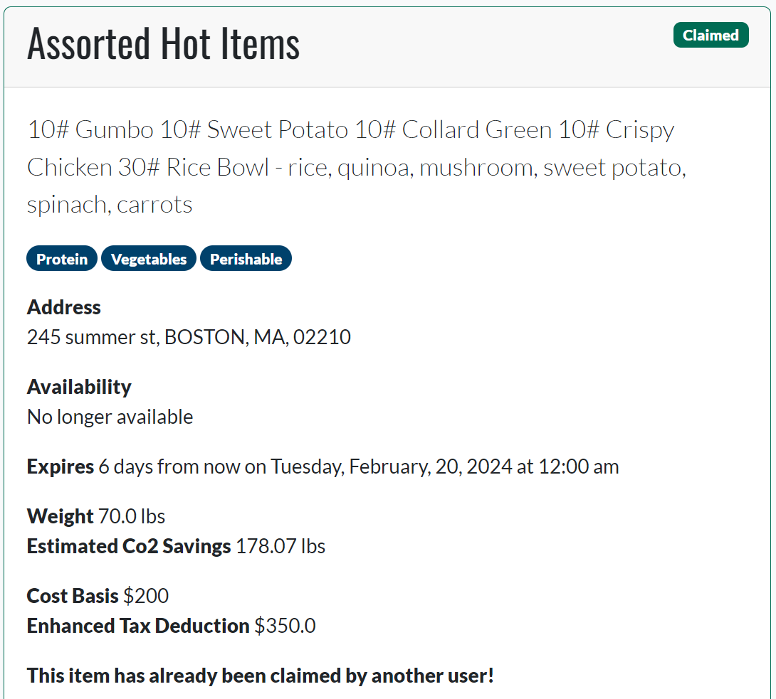
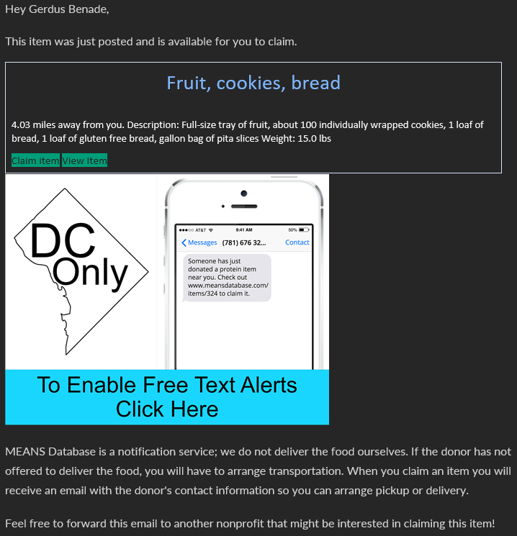

Food rescue operations
Act as a matching platform between donors and recipients
Notes:
Emphasize: recipient does transport (trying to offer delivery in a couple of states)
Deadline – expiration or shelf space

Slide 8
Food rescue operations
Act as a matching platform between donors and recipients
YES

Slide 9
Food rescue operations
Act as a matching platform between donors and recipients

Slide 10
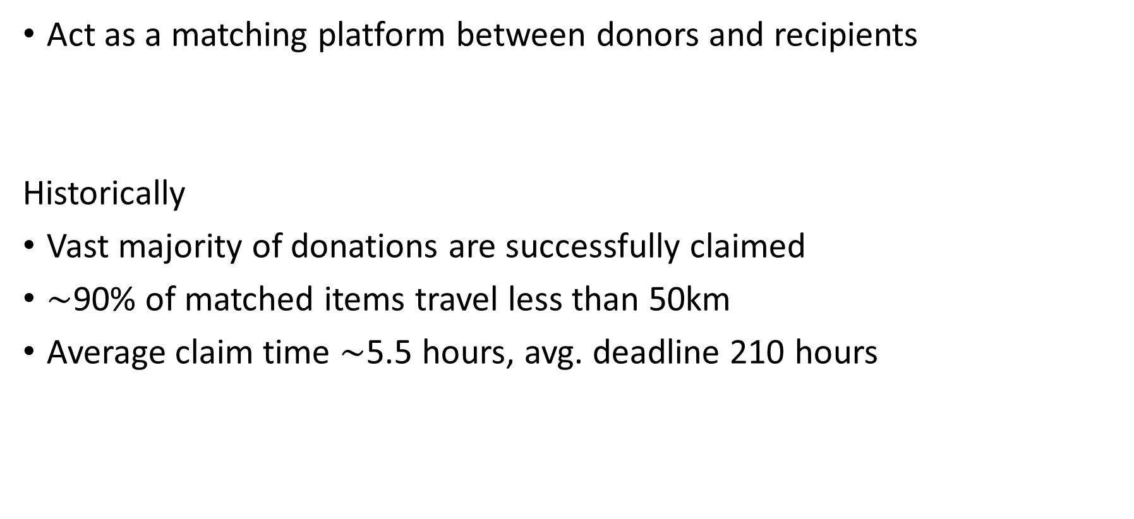
Food rescue operations
Act as a matching platform between donors and recipients
Historically
Vast majority of donations are successfully claimed
$∼$90% of matched items travel less than 50km
Average claim time $∼$5.5 hours, avg. deadline 210 hours
Notes:
Bulk donations separate, drivers experiments in some cities, agreements with recurring donors

Slide 11
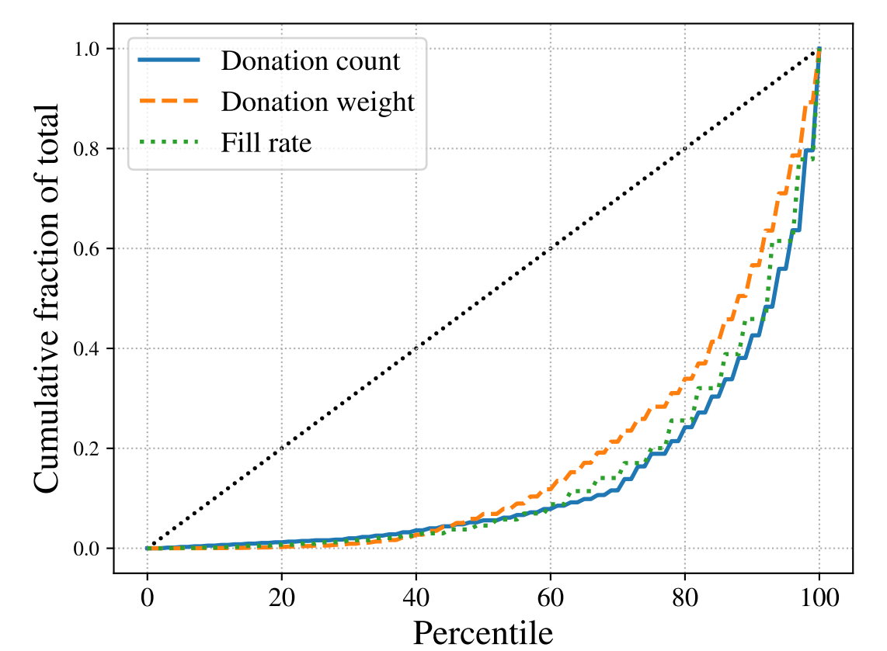
Historical allocations: May 2021 – Sept 2023
Bottom 60% of recipients get 13% of weight
Bottom 60% of recipients get 8% of items
Notes:
Inequity does not disappear when accounting for size, surveys
Optimistic, excludes ~70% of recipients who got nothing
Starting point – minimal changes to improve fairness
NB: currently once an interested recipient interacts, immediate answer.
eliminates bidding, best of 2, tokens that let you preemt

Slide 12
Simple idea to improve fairness Prioritize select recipients by giving them a head start

Slide 13



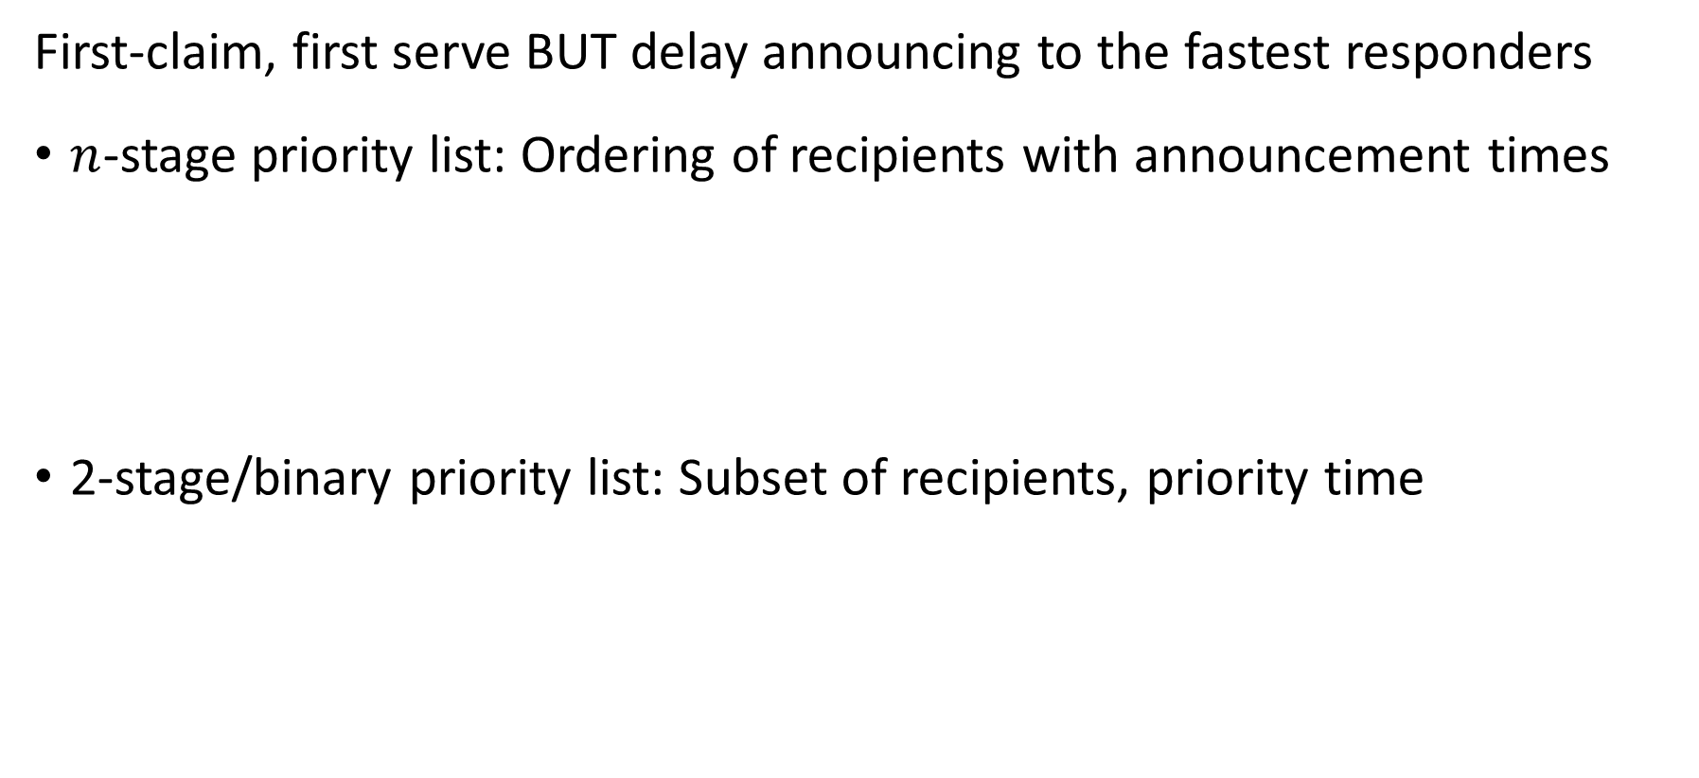
Priority lists
First-claim, first serve BUT delay announcing to the fastest responders
$n$-stage priority list: Ordering of recipients with announcement times
2-stage/binary priority list: Subset of recipients, priority time
0
1hr
3hrs
2 days
0
2hrs
2 days
Notes:
You could imagine other things, artificial currency, wait for two to respond give to worst-off etc
Added benefit – existed in some form eg church of some denomination prefers donation goes to food pantry of same denomination

Slide 14
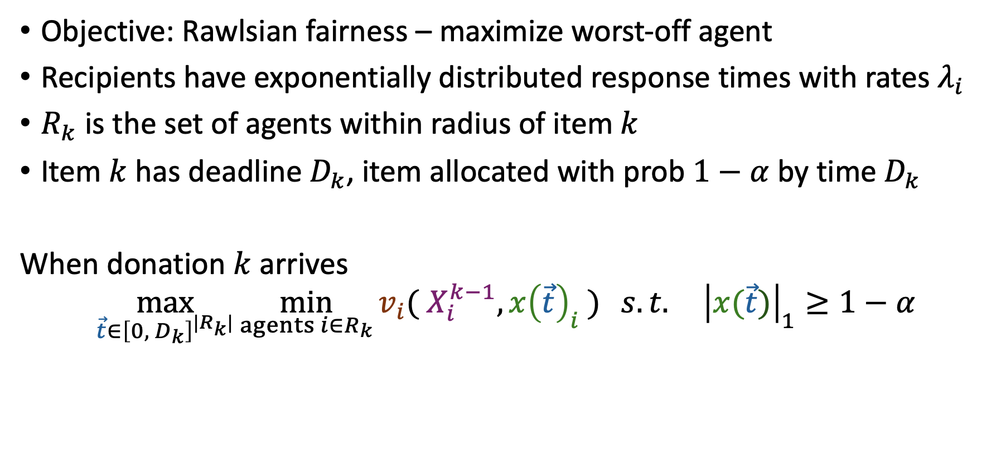
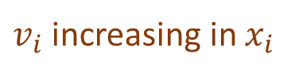
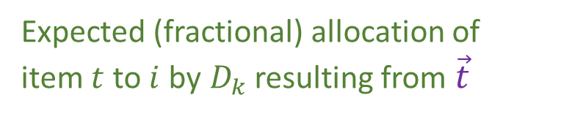
Model
Objective: Rawlsian fairness – maximize worst-off agent
Recipients have exponentially distributed response times with rates $λ_{i}$
$R_{k}$ is the set of agents within radius of item $k$
Item $k$ has deadline $D_{k}$, item allocated with prob $1−α$ by time $D_{k}$
When donation $k$ arrives
$$\max_{\vec{t}∈{\left[0,{ D}_{k}\right]}^{|R_{k}|}}{\min_{agents i∈R_{k}}{v_{i}( X_{i}^{k−1}, x{\left(\vec{t}\right)}_{i} )} s.t. {\left|x(\vec{t})\right|}_{1}≥1−α}$$
Wastage constraint
Existing allocation of prior items
$v_{i}$ increasing in $x_{i}$
Expected (fractional) allocation of item $t$ to $i$ by$D_{k}$ resulting from $\vec{t}$
Vector of announcement times
Number/lbs of items
Frac. of agent’s demand
Recipient-specific utilities
Notes:
Objective – max unique recipients. Little demand information, couple of surveys, contacts etc, still enough uncertainty about what makes a reasonable objective.
Compared to traditional allocation problems – do not decide allocation. FCFS nature takes care of some downstream lack of information

Slide 15

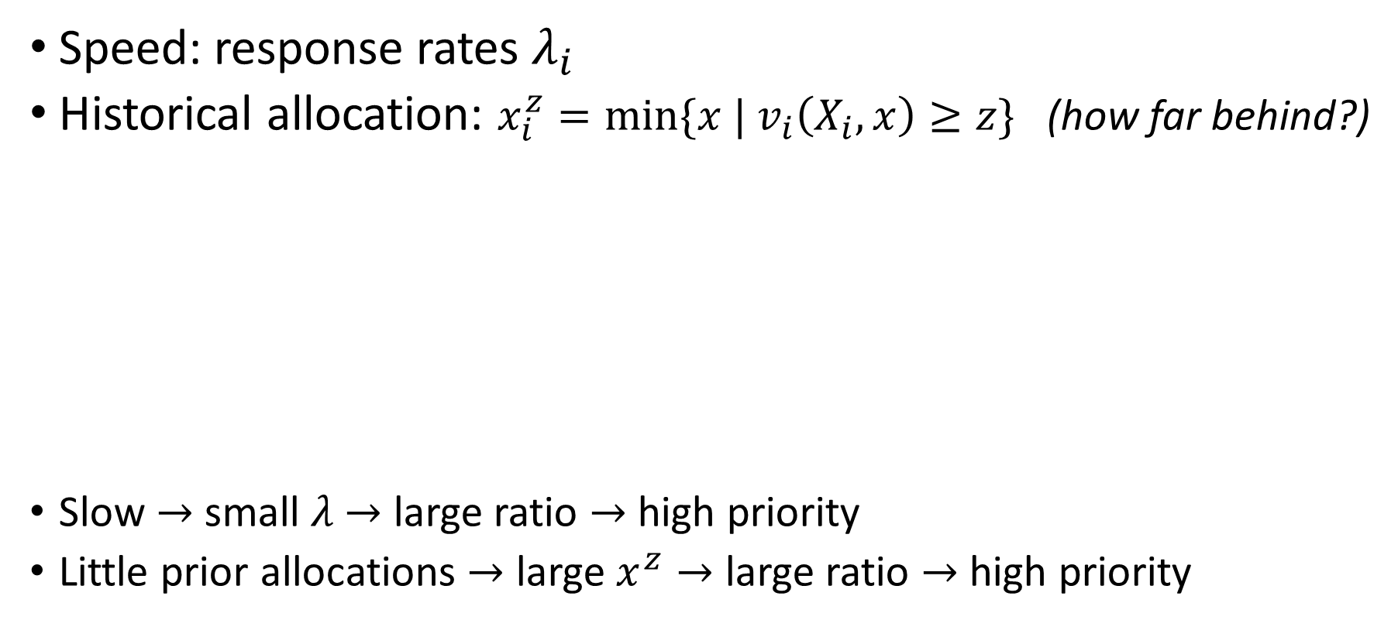

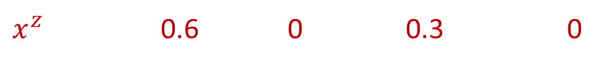


A simple priority index for optimal priority lists
Speed: response rates $λ_{i}$
Historical allocation: $x_{i}^{z}=\min{\{x |{ v}_{i}\left(X_{i}, x\right)≥z\}}$ (how far behind?)
Slow $→$ small $λ$ $→$ large ratio $→$ high priority
Little prior allocations $→$ large $x^{z}→$ large ratio $→$ high priority
Valuation: weight received
$$\text{Target} z=10$$
New item: weight 10
$$6$$
$$3$$
10
14
4
7
$x^{z}$ 0.6 0 0.3 0
Prioritize recipients by decreasing $x_{i}^{z}/λ_{i}$
need / rate $≈$ how long you need
Notes:
From now on index in this decreasing order

Slide 16
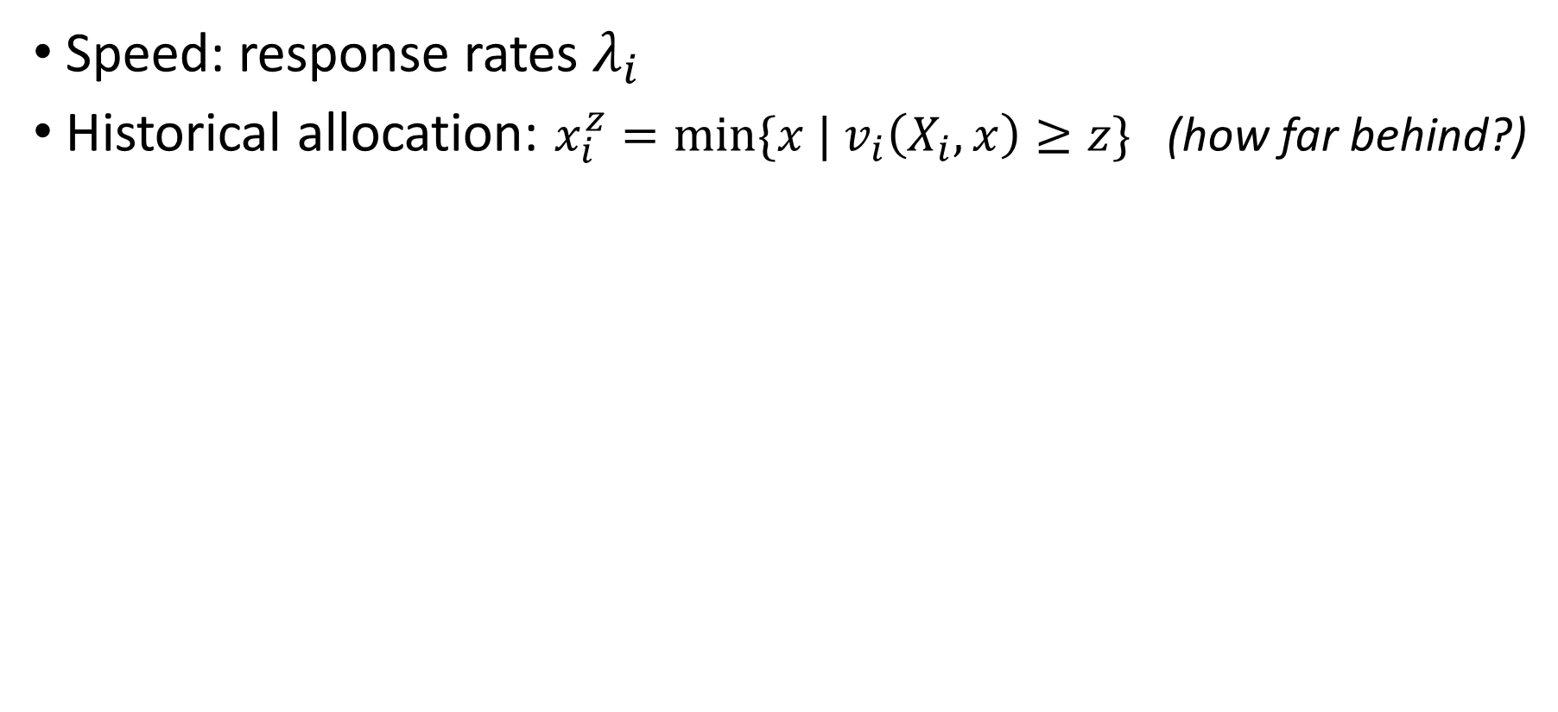
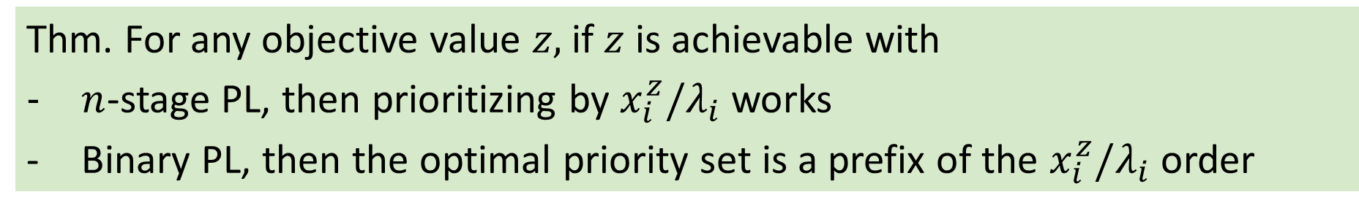
A simple priority index for optimal priority lists
Speed: response rates $λ_{i}$
Historical allocation: $x_{i}^{z}=\min{\{x |{ v}_{i}\left(X_{i}, x\right)≥z\}}$ (how far behind?)
Prioritize recipients by decreasing $x_{i}^{z}/λ_{i}$
Thm. For any objective value $z,$ if $z$ is achievable with
$n$-stage PL, then prioritizing by $x_{i}^{z}/λ_{i}$ works
Binary PL, then the optimal priority set is a prefix of the $x_{i}^{z}/λ_{i}$ order
Notes:
From now on index in this decreasing order

Slide 17
Quantifying the practical impact of priority lists

Slide 18
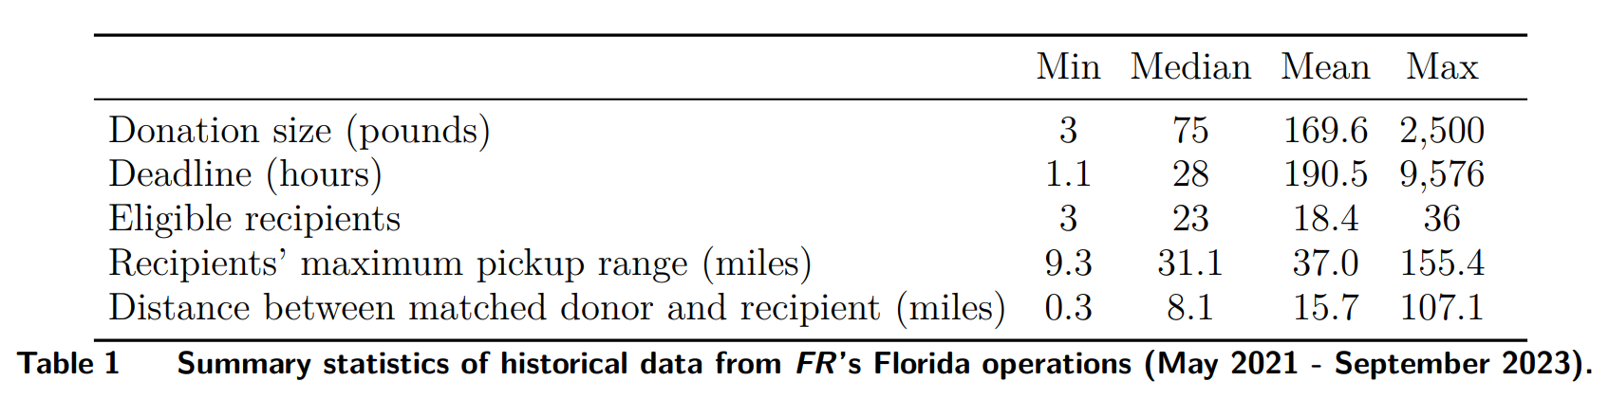
Simulations calibrated by operations in Florida
Allocation data 2021-2023
Estimate response rates
Draw donors, donation sizes, deadlines from historical distributions
Three valuation functions: Number of items, total pounds, value
Notes:
65% claimed by 1 hour; 60% items available for 1 day
Value sampled according to observations from Prendergast feeding america

Slide 19
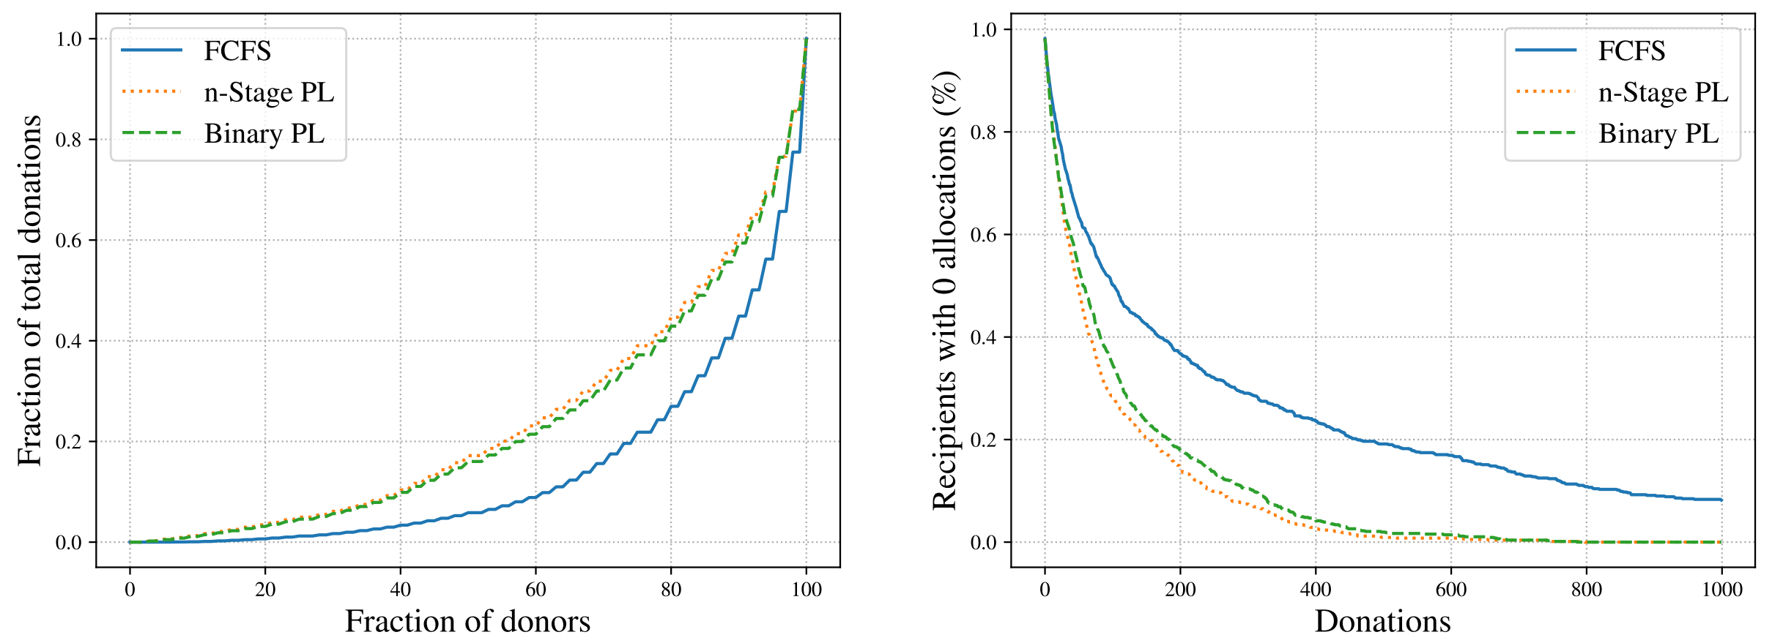
More equitable distributions
Notes:
No increase in waste

Slide 20
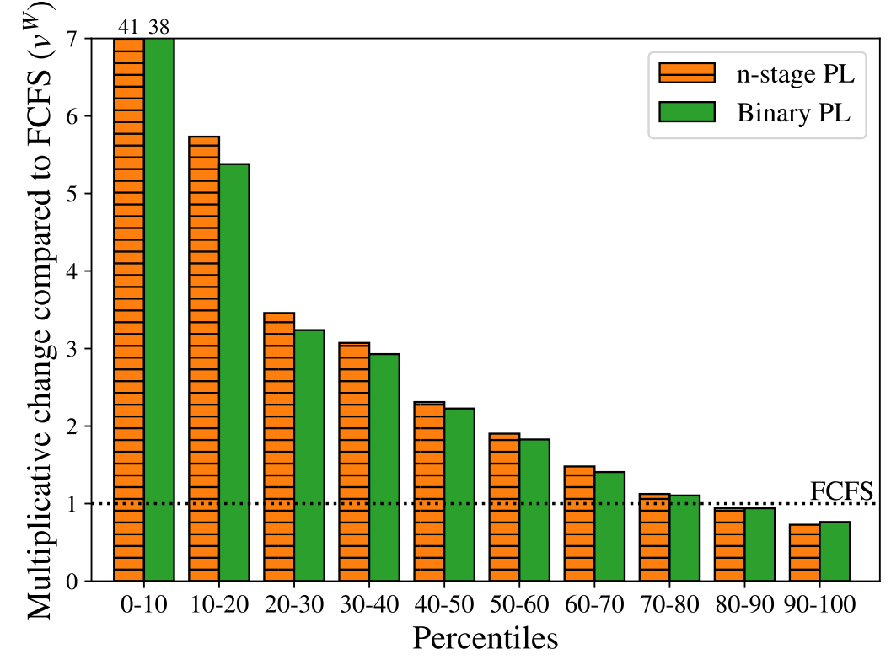
Redistribution of value
Notes:
No increase in waste

Slide 21
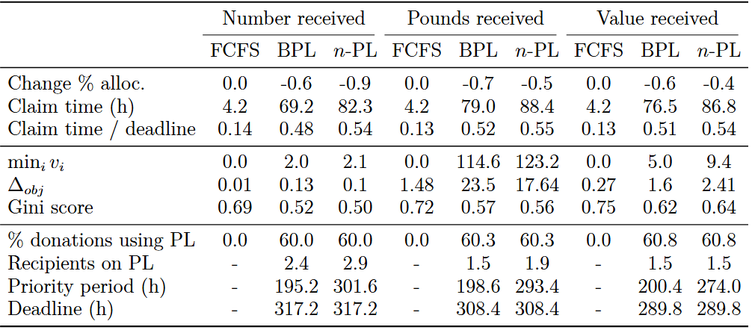
Similar efficiency, slower claim times
Notes:
No increase in waste

Slide 22
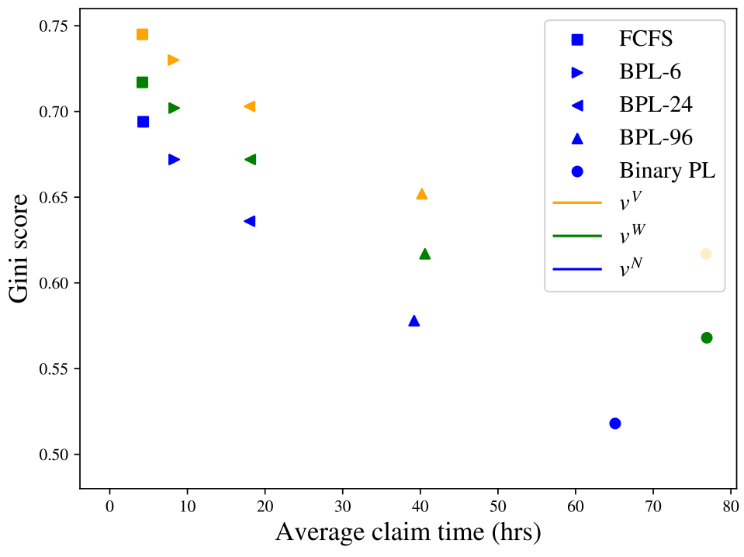
Optimal trade off: fairness and increased claim times
Optimal PL s.t. upper bound on the maximum delay in any notification
Notes:
Binary priority lists

Slide 23

Wrapping up
Pilot started in June
Ongoing: improving data collection and transparency
Open questions:
Other fairness notions
When to offer transportation
Storage space and splitting goods
Priority lists significantly improve fairness without increasing waste
Notes:
Fairness notions: likely leximax, mnw cares about similar basic attributes
Online – current one is myopic, what if donations are stochastics
Transportation – in a couple of places grants fund transportation. Which matches?
Bulk donations – no storage space, some donations benefit from splitting. How to incentivize

Slide 24
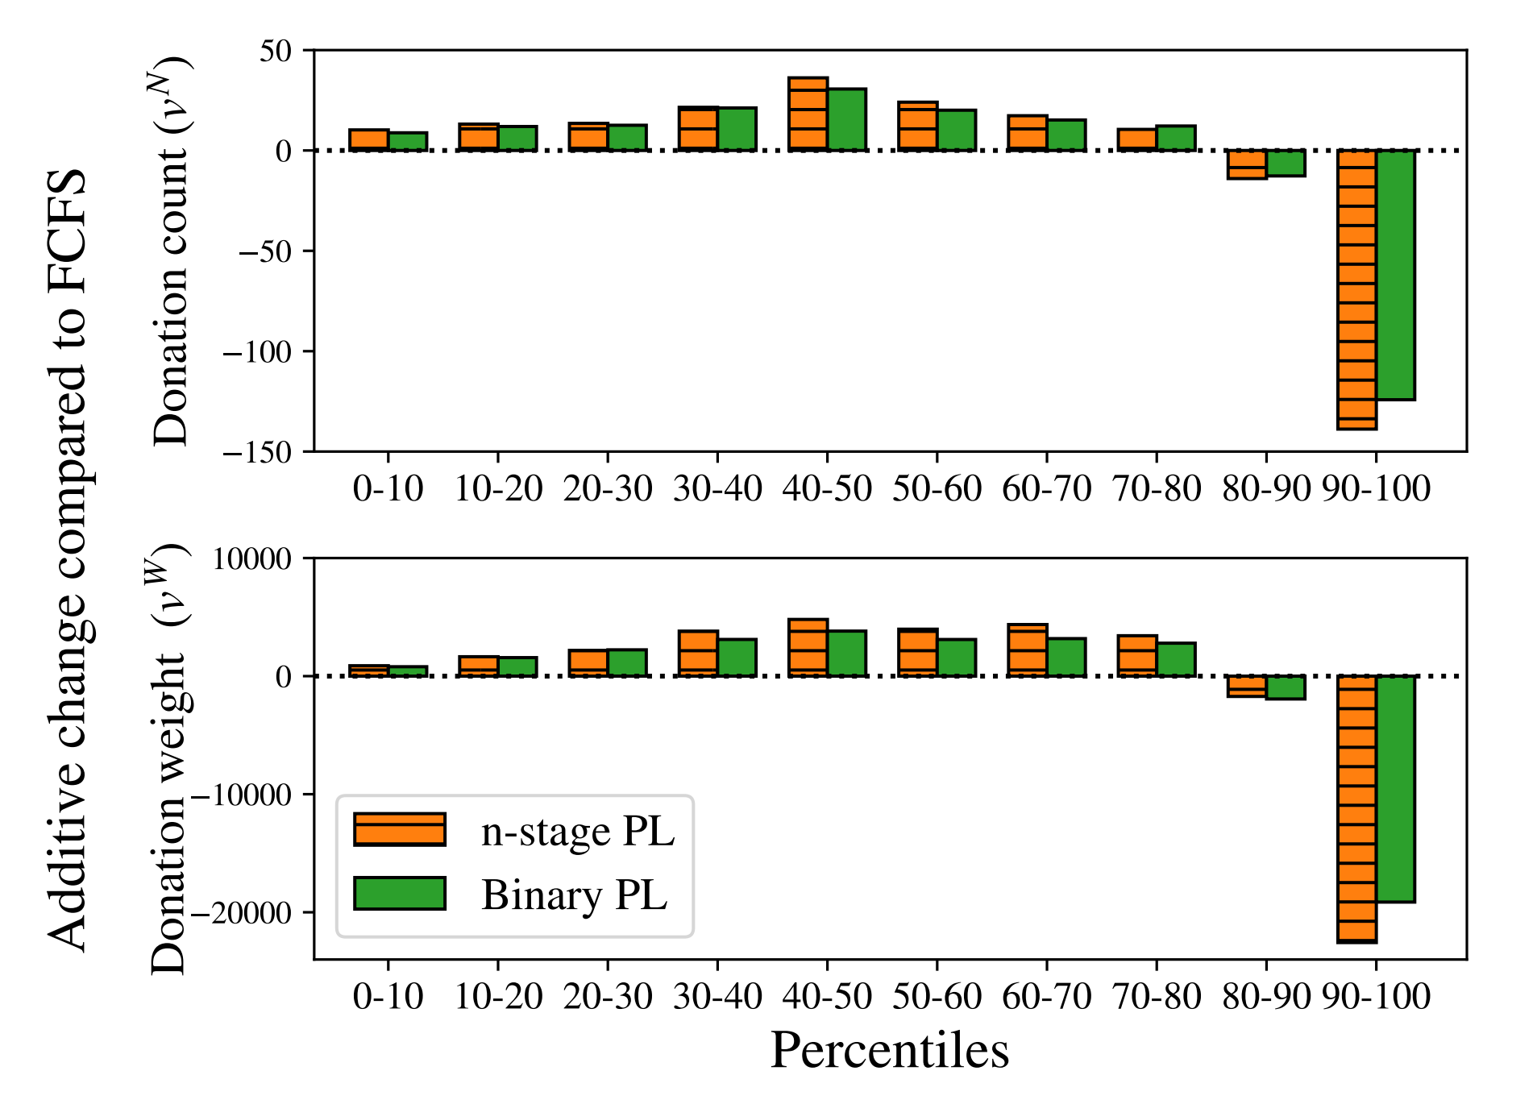
Redistribution
*Additive change
by decile

Slide 25
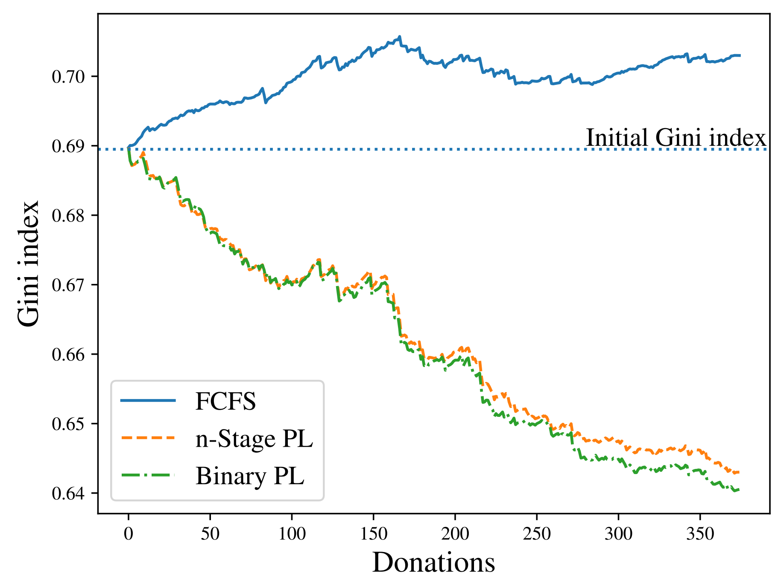
Starting from an inequitable historical state

Slide 26
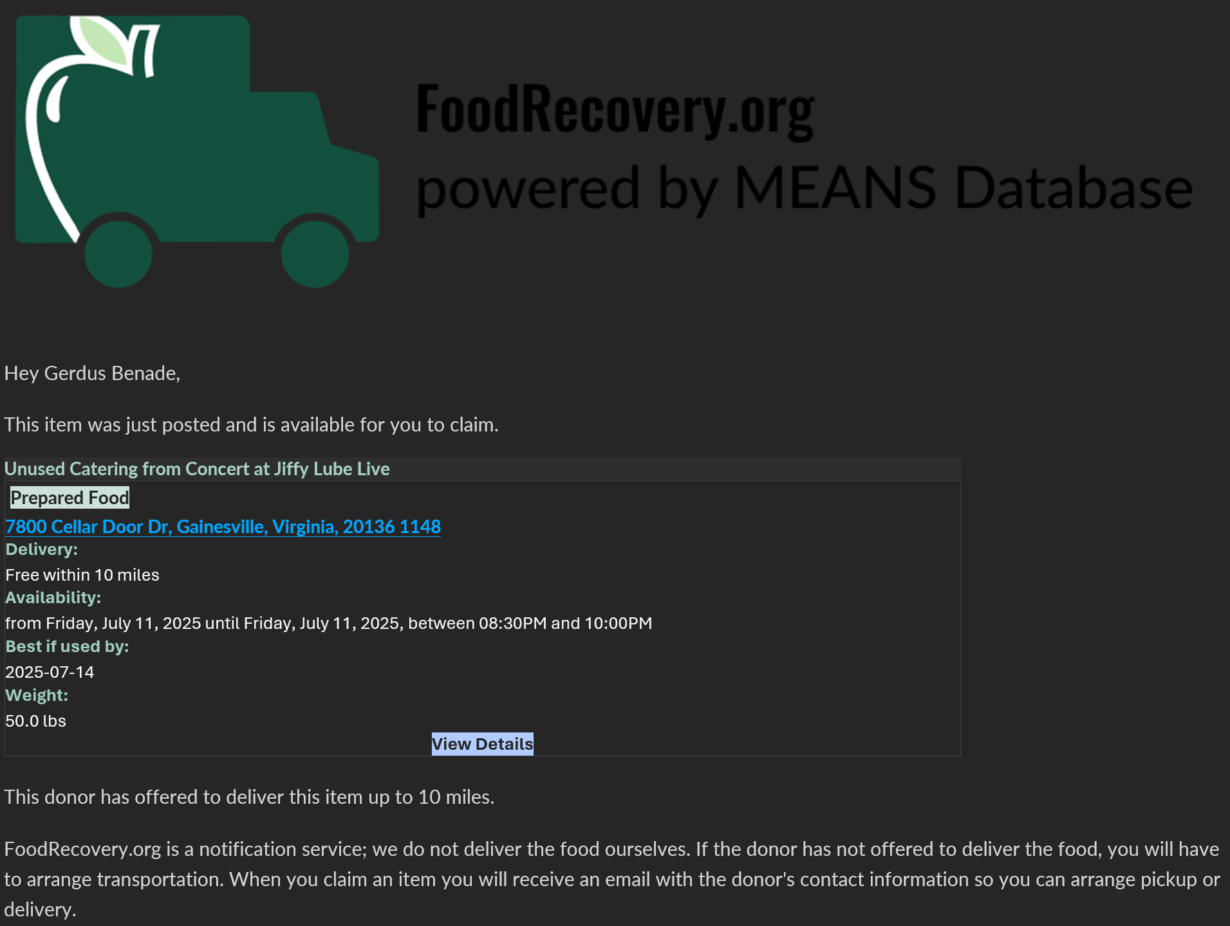

Slide 27
Setting: a national food rescue platform
Active in 50 states in the US
Distributed 2.9M pounds of food in 2022, 81M in 2024
Acts as a matching platform between donors and recipients
We focus on donations below 3,000 pounds
Existing FCFS (first-come-first-serve) matching – first to claim a posted donation gets it, which results in inequities in distribution
Goal: To improve fairness outcomes in such food rescue platforms that operate on the basis of FCFS matching
Notes:
FL in 2023: ~20 mil pounds. Exciting time to be involved with them.

Slide 28

Food rescue operations
Act as a matching platform between donors and recipients
YES
Notes:
Don’t know, and can’t elicit, agent values
We don’t get to make an allocation

Slide 29
Food rescue operations
Act as a matching platform between donors and recipients
Notes:
Don’t know, and can’t elicit, agent values
We don’t get to make an allocation

Slide 30
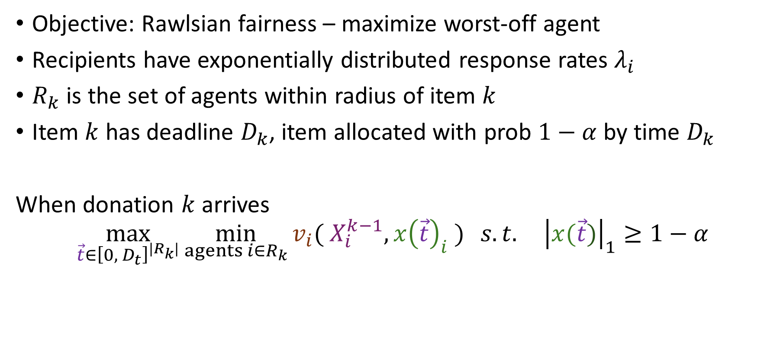
Model
Objective: Rawlsian fairness – maximize worst-off agent
Recipients have exponentially distributed response rates $λ_{i}$
$R_{k}$ is the set of agents within radius of item $k$
Item $k$ has deadline $D_{k}$, item allocated with prob $1−α$ by time $D_{k}$
When donation $k$ arrives
$$\max_{\vec{t}∈{\left[0,{ D}_{t}\right]}^{|R_{k}|}}{\min_{agents i∈R_{k}}{v_{i}( X_{i}^{k−1}, x{\left(\vec{t}\right)}_{i} )} s.t. {\left|x(\vec{t})\right|}_{1}≥1−α}$$
Wastage constraint
Existing allocation of prior items
Expected (fractional) allocation of item $t$ to $i$ by$D_{k}$ resulting from $\vec{t}$
Vector of announcement times
Notes:
Objective – max unique recipients. Little demand information, couple of surveys, contacts etc, still enough uncertainty about what makes a reasonable objective.
Compared to traditional allocation problems – do not decide allocation. FCFS nature takes care of some downstream lack of information

Slide 31
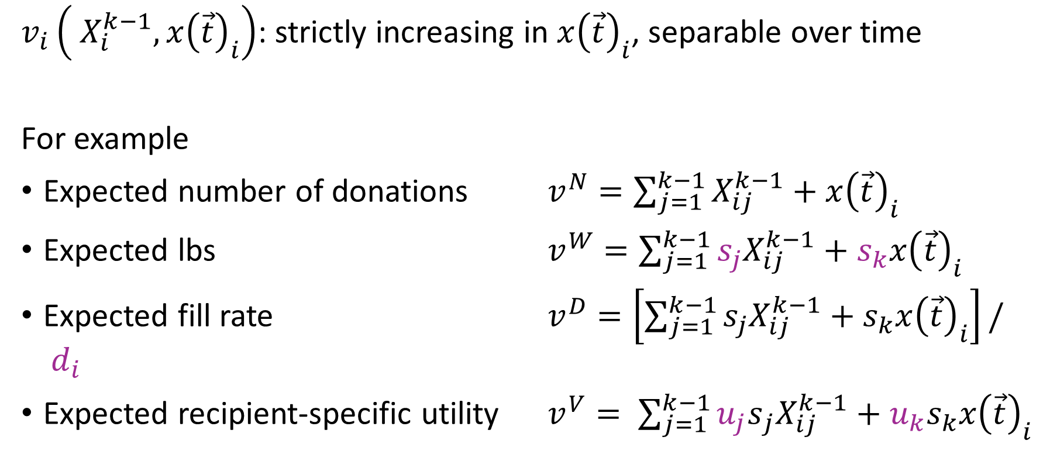
Valuation function
$v_{i}\left( X_{i}^{k−1}, x{\left(\vec{t}\right)}_{i}\right)$: strictly increasing in $x{\left(\vec{t}\right)}_{i}$, separable over time
For example
Expected number of donations $v^{N}=\sum_{j=1}^{k−1}{X_{ij}^{k−1}}+x{\left(\vec{t}\right)}_{i}$
Expected lbs $v^{W}=\sum_{j=1}^{k−1}{s_{j}X_{ij}^{k−1}}+s_{k}x{\left(\vec{t}\right)}_{i}$
Expected fill rate $v^{D}=\left[\sum_{j=1}^{k−1}{s_{j}X_{ij}^{k−1}}+s_{k}x{\left(\vec{t}\right)}_{i}\right]/ d_{i}$
Expected recipient-specific utility $v^{V}= \sum_{j=1}^{k−1}{{u_{j}s}_{j}X_{ij}^{k−1}}+{u_{k}s}_{k}x{\left(\vec{t}\right)}_{i}$

Slide 32
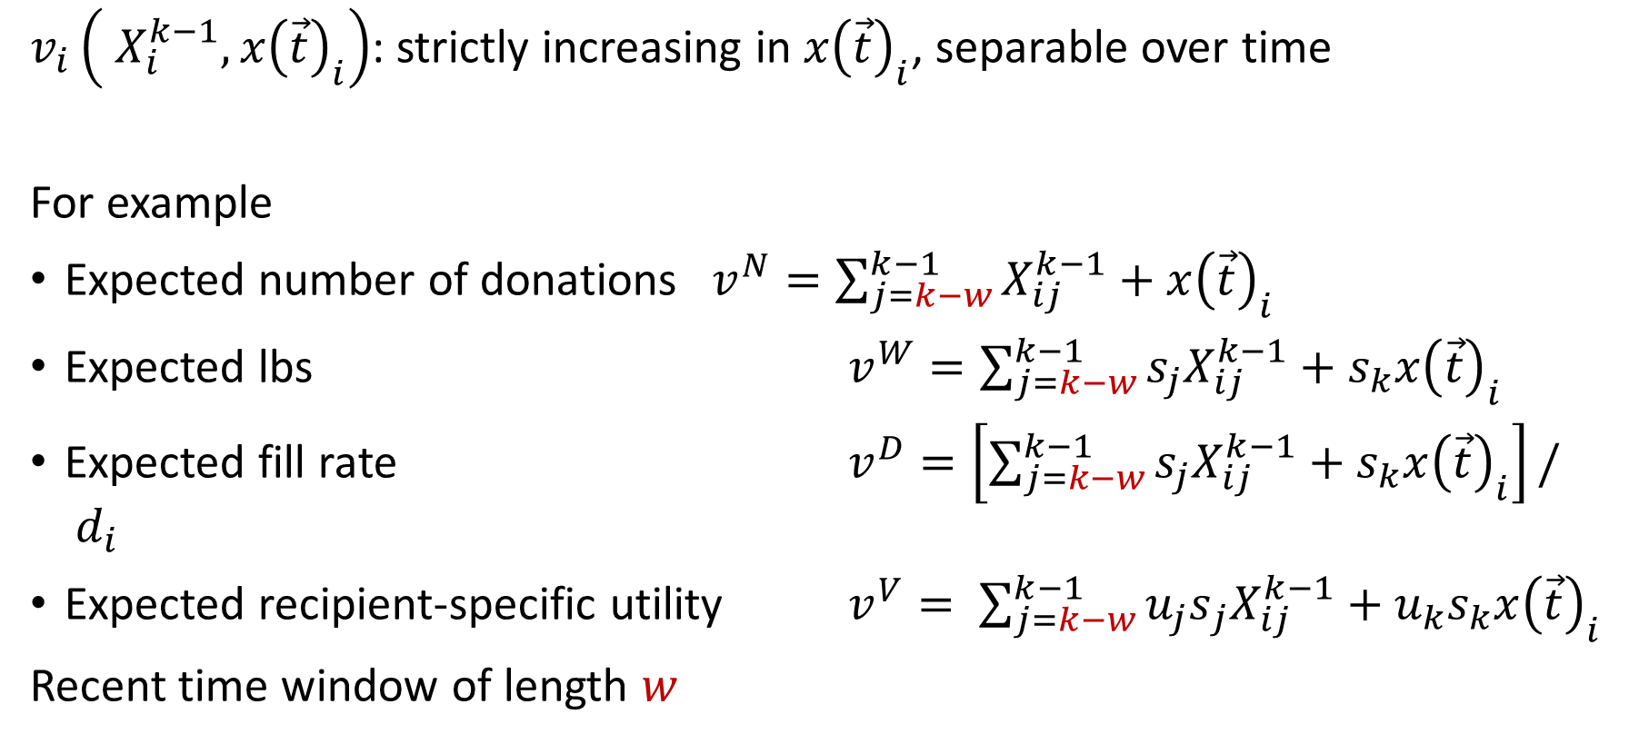
Valuation function
$v_{i}\left( X_{i}^{k−1}, x{\left(\vec{t}\right)}_{i}\right)$: strictly increasing in $x{\left(\vec{t}\right)}_{i}$, separable over time
For example
Expected number of donations $v^{N}=\sum_{j=k−w}^{k−1}{X_{ij}^{k−1}}+x{\left(\vec{t}\right)}_{i}$
Expected lbs $v^{W}=\sum_{j=k−w}^{k−1}{s_{j}X_{ij}^{k−1}}+s_{k}x{\left(\vec{t}\right)}_{i}$
Expected fill rate $v^{D}=\left[\sum_{j=k−w}^{k−1}{s_{j}X_{ij}^{k−1}}+s_{k}x{\left(\vec{t}\right)}_{i}\right]/ d_{i}$
Expected recipient-specific utility $v^{V}= \sum_{j=k−w}^{k−1}{{u_{j}s}_{j}X_{ij}^{k−1}}+{u_{k}s}_{k}x{\left(\vec{t}\right)}_{i}$
Recent time window of length $w$

Slide 33
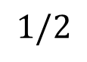
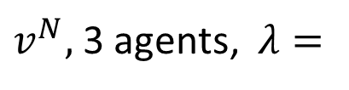

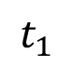

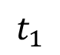
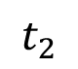
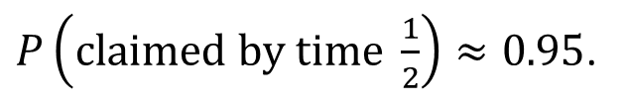

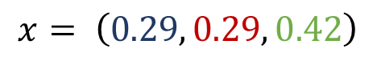
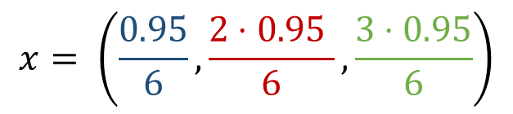
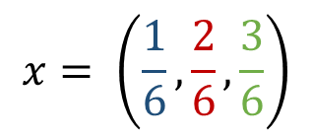
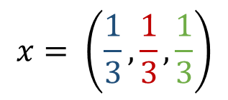

Example
1
2
3
$v^{N},$3 agents, $λ=$
No deadline, no priority list
$$x= \left(\frac{1}{6},\frac{2}{6},\frac{3}{6}\right)$$
0
$$∞$$
No deadline, n-stage priority list
$$x= \left(\frac{1}{3},\frac{1}{3},\frac{1}{3}\right)$$
0
$$∞$$
$$t_{1}$$
$$t_{2}$$
No deadline, binary priority list
$$x= \left(0.29, 0.29, 0.42\right)$$
0
$$∞$$
$$t_{1}$$
Deadline of ½, $α=0.05,$ n-stage priority list
$P\left(claimed by time \frac{1}{2}\right)≈0.95$.
$$x= \left(\frac{0.95}{6},\frac{2⋅0.95 }{6},\frac{3⋅0.95}{6}\right)$$
0
$$1/2$$
Notes:
n-stage can achieve any fraction without deadline, 2 stage obviously cant

Slide 34
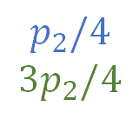
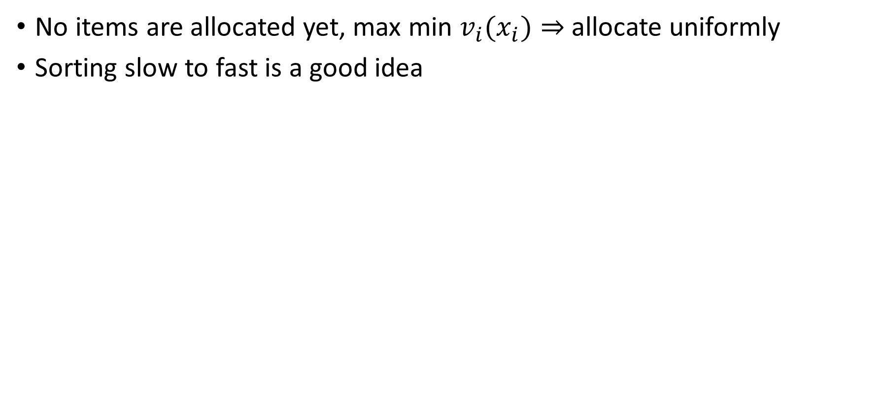

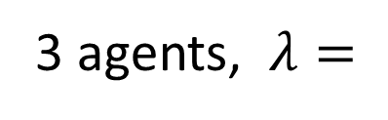
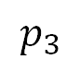
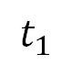
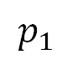
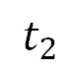
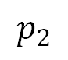
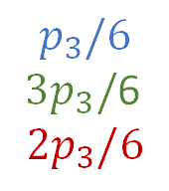
Warm-up: Allocating the first item
No items are allocated yet, max min ${v_{i}(x}_{i})⇒$ allocate uniformly
Sorting slow to fast is a good idea
3 agents, $λ=$
1
2
3
$$p_{1}$$
$$p_{2}$$
$$p_{3}$$
0
$$t_{1}$$
$$t_{2}$$
$$p_{1}$$
$$p_{2}/4$$
$$3p_{2}/4$$
$$p_{3}/6$$
$3p_{3}/$6
$$2p_{3}/6$$
doesn’t need a head-start over
3
2
Notes:
Suppose we don’t sort slow to fast

Slide 35


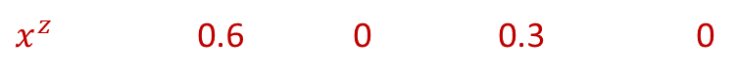



A simple priority index for optimal priority lists
Speed: response rates $λ_{i}$
Historical allocation: $x_{i}^{z}=\min{\{x |{ v}_{i}\left(X_{i}, x\right)≥z\}}$ (how far behind?)
Slow $→$ small $λ$ $→$ large ratio $→$ high priority
Little prior allocations $→$ large $x^{z}→$ large ratio $→$ high priority
Valuation: weight received
$$\text{Target} z=10$$
New item: weight 10
$$6$$
$$3$$
10
14
4
7
$x^{z}$ 0.6 0 0.3 0
Prioritize recipients by decreasing $x_{i}^{z}/λ_{i}$
Thm. For any objective value $z,$ if $z$ is achievable with
$n$-stage PL, then prioritizing by $x_{i}^{z}/λ_{i}$ works
Binary PL, then the optimal priority set is a prefix of the $x_{i}^{z}/λ_{i}$ order
need / rate $≈$ how long you need
Notes:
From now on index in this decreasing order

Slide 36
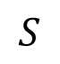
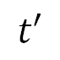
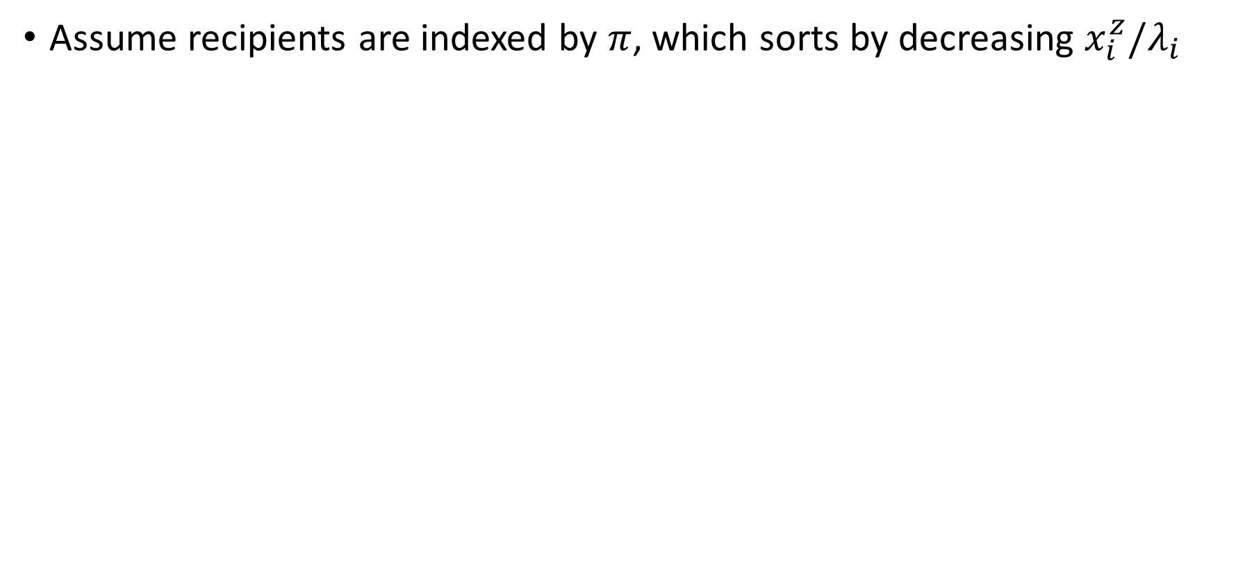
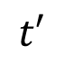
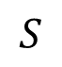










Binary priority lists
Assume recipients are indexed by $π$, which sorts by decreasing $x_{i}^{z}/λ_{i}$
Lemma. Given BPL $(S, t)$, if $S$ is not a prefix of $π,$ you can find $S_{1}⊂S⊂S_{2}, t^{′}$ so that the schedules $\left(S, t\right)$ and $[\left(S_{1},t^{′}\right),(S_{2}, t−t′)]$ have:
Equal P(donation claimed by $t)$
$x_{i}^{′}\left(t\right)≥x_{i}\left(t\right) ∀$ $i∉S∖S_{1}$
$$S$$
$$t$$
$$S_{1}$$
$$t′$$
$$S_{2}$$
$$t$$
Thm. For any objective value $z,$ if $z$ is achievable with an $n$-stage priority list, then prioritizing by $x_{i}^{z}/λ_{i}$ works
$$S$$
1
2
4
$$t$$
1
2
3
4
Thm. The optimal priority set in a binary priority list is some prefix of $π.$
Given the set you can find the optimal priority time with a linear program.
1
2
$$t′$$
1
2
3
4
$$t$$
1
2
3
4
$$S_{1}$$
$$S_{2}$$
Notes:
If original satisfies allocation constraint, we still do
Objective weakly increases

Slide 37


Binary priority lists
Assume recipients are indexed by $π$, which sorts by decreasing $x_{i}^{z}/λ_{i}$
Combine with binary search over $z$, checking $n$ prefixes each time
Lemma. Given BPL $(S, t)$, if $S$ is not a prefix of $π,$ you can find $S_{1}⊂S⊂S_{2}, t^{′}$ so that the schedules $\left(S, t\right)$ and $[\left(S_{1},t^{′}\right),(S_{2}, t−t′)]$ have:
Equal P(donation claimed by $t)$
$x_{i}^{′}\left(t\right)≥x_{i}\left(t\right) ∀$ $i∉S∖S_{1}$
$$S$$
$$t$$
$$S_{1}$$
$$t′$$
$$S_{2}$$
$$t$$
Thm. Any achievable $z$ can be achieved with a prefix of $π$ as priority set.
Given the set, find the optimal priority time with an LP.
Notes:
Binary search over z

Slide 38





$n$-stage priority lists
Lemma 1. Given BPL $(S, t)$, if $S$ is not a prefix of $π,$ you can find $S_{1}⊂S⊂S_{2}, t^{′}$:
Equal P(claimed by $t)$ and $x_{i}^{′}\left(t\right)≥x_{i}\left(t\right) ∀$ $i∉S∖S_{1}$
Initial PL
3
13
134
1234
3142
Repeated
decomp.
$$∅$$
13
1
123
1
1234
1234
Lemma 1 +
memoryless
$$∅$$
1
123
1
123
1
1234
1234
$$D_{t}$$

Slide 39

$n$-stage priority lists
Lemma 1. Given BPL $(S, t)$, if $S$ is not a prefix of $π,$ you can find $S_{1}⊂S⊂S_{2}, t^{′}$:
Equal P(claimed by $t)$ and $x_{i}^{′}\left(t\right)≥x_{i}\left(t\right) ∀$ $i∉S∖S_{1}$
Lemma 2. Consider consecutive periods $\left(H, t_{H}\right), \left(L, t_{L}\right).$If $λ\left(H\right)>λ\left(L\right),$then there exists $t_{H}^{′}, t_{L}^{′}$ so that $t_{H}^{′}+t_{L}^{′}≤t_{H}+t_{L}$ and all allocation probabilities remain the same in the schedule$\left(L, t_{L}^{′}\right),\left(H, t_{H}^{′}\right)$
Initial PL
3
13
134
1234
3142
Repeated
decomp.
$$∅$$
13
1
123
1
1234
1234
Lemma 1 +
memoryless
$$∅$$
1
123
1
123
1
1234
1234
$$D_{t}$$

Slide 40

$n$-stage priority lists
Lemma 1. Given BPL $(S, t)$, if $S$ is not a prefix of $π,$ you can find $S_{1}⊂S⊂S_{2}, t^{′}$:
Equal P(claimed by $t)$ and $x_{i}^{′}\left(t\right)≥x_{i}\left(t\right) ∀$ $i∉S∖S_{1}$
Lemma 2. Consider consecutive periods $\left(H, t_{H}\right), \left(L, t_{L}\right).$If $λ\left(H\right)>λ\left(L\right),$then there exists $t_{H}^{′}, t_{L}^{′}$ so that $t_{H}^{′}+t_{L}^{′}≤t_{H}+t_{L}$ and all allocation probabilities remain the same in the schedule$\left(L, t_{L}^{′}\right),\left(H, t_{H}^{′}\right)$
Initial PL
3
13
134
1234
3142
Repeated
decomp.
$$∅$$
13
1
123
1
1234
1234
Lemma 1 +
memoryless
$$∅$$
1
123
1
123
1
1234
1234
$$D_{t}$$
Final PL
$$∅$$
1
1
1
123
123
1234
1234
Lemma 2
1234

Slide 41


$n$-stage priority lists
Lemma 1. Given BPL $(S, t)$, if $S$ is not a prefix of $π,$ you can find $S_{1}⊂S⊂S_{2}, t^{′}$:
Equal P(claimed by $t)$ and $x_{i}^{′}\left(t\right)≥x_{i}\left(t\right) ∀$ $i∉S∖S_{1}$
Lemma 2. Consider consecutive periods $\left(H, t_{H}\right), \left(L, t_{L}\right).$If $λ\left(H\right)>λ\left(L\right),$then there exists $t_{H}^{′}, t_{L}^{′}$ so that $t_{H}^{′}+t_{L}^{′}≤t_{H}+t_{L}$ and all allocation probabilities remain the same in the schedule$\left(L, t_{L}^{′}\right),\left(H, t_{H}^{′}\right)$
Thm. For any objective value $z,$ if $z$ is achievable with an $n$-stage priority list, then prioritizing by $x_{i}^{z}/λ_{i}$ works

Slide 42
Notes:
No increase in waste

Slide 43
Notes:
No increase in waste

Slide 44
Related Work
Food rescue in OM
Ata et al. (2019), Manshadi and Rodilitz (2022)
Food waste in OM
Akkaş (2019), Akkaş and Gaur (2022), Akkaş and Honhon (2022, 2023), Belavina (2021), Wu and Honhon (2023), …
Fairness (motivated by a food donation context)
Lee et al. (2019), Manshadi et al. (2023), Prendergast (2022), Shi et al. (2020), Sinclair et al. (2022), …
Notes:
Both food rescue papers are about volunteer management

Slide 45



Slide 46
Our theory doesn’t really fit
Model
Here
Items arrive online
Agents have values for items
Fairness metric: envy
Algorithm decides allocation
Items arrive online
We don’t know item values
Can’t use envy as metric
Algorithm doesn’t get to allocate
Response rates

Slide 47




Priority lists
First-claim, first serve BUT delay announcing to the fastest responders
$n$-stage priority list: Ordering of recipients with announcement times
2-stage/binary priority list: Subset of recipients, priority time
1hr
3hrs
2 days
0
2hrs
2 days
0
Notes:
You could imagine other things, artificial currency, wait for two to respond give to worst-off etc

Slide 48


Model
Objective: Rawlsian fairness – maximize worst-off agent
Recipients have exponentially distributed response rates $λ_{i}$
$R_{k}$ is the set of agents within radius of item $k$
Item $k$ has deadline $D_{k}$, item allocated with prob $1−α$ by time $D_{k}$
When donation $k$ arrives
$$\max_{x∈F(D_{k})}{\min_{agents i∈R_{k}}{v_{i}\left( X_{i}^{k−1}, x_{i} \right) } s.t. {\left|x\right|}_{1}≥1−α}$$
Wastage constraint
Existing allocation of prior items
$v_{i}$ increasing in $x_{i}$
Expected (fractional) allocation of item $t$ to $i$ by$D_{k}$
Feasible fractional allocations by deadline
Number of items
Pounds of items
Frac. of agent’s demand
Notes:
Objective – max unique recipients. Little demand information, couple of surveys, contacts etc, still enough uncertainty about what makes a reasonable objective.

Slide 49




Model
Objective: Rawlsian fairness – maximize worst-off agent
Recipients have exponentially distributed response rates $λ_{i}$
$R_{t}$ is the set of agents within radius of item $t$
Item $t$ has deadline $D_{t}$, item allocated with prob $1−α$ by time $D_{t}$
When donation $t$ arrives
$$\max_{x}{\min_{agents i∈R_{t}}{v_{i}( X_{i}^{t−1}, x )} s.t. {\left|x\right|}_{1}≥1−α}$$
Existing allocation of prior items
Wastage constraint
Expected allocation of item $t$
$v_{i}$ increasing in $x_{i}$
$x$ is expected outcome of priority list by time $D_{t}$
Number of items
Pounds of items
Frac. of agent’s demand
Notes:
Objective – max unique recipients. Little demand information, couple of surveys, contacts etc, still enough uncertainty about what makes a reasonable objective.

Slide 50











Example
1
2
3
3 agents, $λ=$
No deadline, no priority list
$$x= \left(\frac{1}{6},\frac{2}{6},\frac{3}{6}\right)$$
0
$$∞$$
No deadline, n-stage priority list
$$x= \left(\frac{1}{3},\frac{1}{3},\frac{1}{3}\right)$$
0
$$∞$$
$$t_{1}$$
$$t_{2}$$
Deadline of ½, $α=0.05,$ n-stage priority list
$P\left(claimed by time \frac{1}{2}\right)≈0.95$.
$$x= \left(\frac{0.95}{6},\frac{2⋅0.95 }{6},\frac{3⋅0.95}{6}\right)$$
0
$$1/2$$
Notes:
n-stage can achieve any fraction without deadline, 2 stage obviously cant

Slide 51



$$X= \left(\frac{1}{6},\frac{2}{6},\frac{3}{6}\right)$$
1
2
3
$$t_{2}$$
$$t_{3}$$
$$X= \left(\frac{1}{3},\frac{1}{3},\frac{1}{3}\right)$$
1
1
2
1
2
3

Slide 52











Allocating the first item
No items are allocated yet, max min ${v_{i}(x}_{i})⇒$ allocate uniformly
Sorting slow to fast is a good idea
0
$$∞$$
$$t_{1}$$
$$t_{2}$$
$$p_{1}$$
$$p_{2}$$
$$p_{3}$$
$$t_{1}$$
$$t_{2}$$
1
3
2
$$p_{1}$$
$$p_{2}/4$$
$$3p_{2}/4$$
$$p_{3}/6$$
$3p_{3}/$6
$$2p_{3}/6$$
doesn’t need a head-start over
3
2

Slide 53








Allocating the first item
1
2
3
No items are allocated yet, max min $x_{i}$
Sorting slow to fast is a good idea, $π$
Lemma. Given BPL $(S, t)$, if $S$ is not a prefix of $π,$ you can find $S_{1}⊂S⊂S_{2}, t^{′}$ so that look ‘identical’ on $S_{1}$
$$S$$
$$t$$
$$S_{1}$$
$$t′$$
$$S_{2}$$
$$t$$
Thm. The optimal priority set in a binary priority list is some prefix of $π.$
Given the set you can find the optimal priority time with a linear program.

Slide 54

Designing optimal priority lists – a priority index
First item: Sorting slow to fast is a good idea
Generally: consider response rate ($λ_{i}$) and historical allocation
For any target obj. ${z, x}_{i}^{z}$ is the minimal amount $i$ needs to reach $z$
Let $π$ sort by decreasing $x_{i}^{z}/λ_{i}$
Thm. For any objective value $z,$ if $z$ is achievable with an $n$-stage priority list, then prioritizing by $x_{i}^{z}/λ_{i}$ works
Thm. The optimal priority set in a binary priority list is some prefix of $π.$
Given the set you can find the optimal priority time with a linear program.

Slide 55

Binary priority lists
Sorting slow to fast is a good idea, $π$ sorts this way
For later items, do binary search on the objective function
For any target obj. ${z, x}_{i}^{z}$ is the amount $i$ needs to reach objective value $z$
Sort by decreasing $x_{i}^{z}/λ_{i}$, check all prefixes
Works for valuation functions strictly monotone in $x_{i}$
Thm. The optimal priority set in a binary priority list is some prefix of $π.$
Given the set you can find the optimal priority time with a linear program.

Slide 56

$n$-stage priority lists
Lemma 1. Given BPL $(S, t)$, if $S$ is not a prefix of $π,$ you can find $S_{1}⊂S⊂S_{2}, t^{′}$:
Equal P(claimed by $t)$ and $x_{i}^{′}\left(t\right)≥x_{i}\left(t\right) ∀$ $i∉S∖S_{1}$
Initial PL
3
13
134
1234
3142
Repeated
decomp.
$$∅$$
13
1
123
1
1234
1234
Lemma 1 +
memoryless
$$∅$$
1
123
1
123
1
1234
1234
$$D_{t}$$

